Slide 1

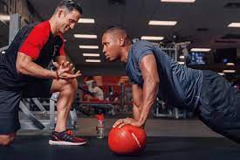
Trainer Link
Joshua Wiser
Joanna Pierre
Leopoldo Aguerrevere
Anthony Johnson

Slide 2
Agenda
Roles
Mission & Core Values
Project Goal
Conceptual Model
Logical Model
Demonstration of Application
Q&A

Slide 3
Roles
Joshua W. ( Project Manager) - Project Planning & Design , Quality Assurance, Problem Solving & Decision Making
Joanna P. ( Brand Strategist) - Head of Marketing, Brand Identity, Ensuring App is User Friendly
Leo A. ( Technical Advisor) - Technical Oversight & Guidance, Innovation & Strategy, Collaboration & Communicaton , And Risk Management
Anthony J. ( Team Member) - User Experience & Interface Design, Engagement & Retention Strategies, Feedback & Improvement , Training & Support

Slide 4

Mission & Core Values of Trainer Link
"At Trainer Link we're dedicated to revolutionizing fitness journeys. Our mission is to connect individuals with expert trainers tailored to their specific sports goals, fostering a community where personalized guidance transforms aspirations into achievements. Join us in redefining fitness, making it accessible and empowering for all."
______________________________________________
Personalization
Community Empowerment
Transparency
Continuous Improvement

Slide 5
Project Goal
We aim to develop a database system connecting qualified trainers with individuals seeking diverse skills training. The platform will allow users to input preferences, considering trainer expertise and availability through a matching algorithm for successful outcomes. A demo is set to be completed within 6-8 months, aligning with the launch of a fitness initiative. The scalable database will initially handle 1,000 trainers on the east coast, with plans for expansion into other territories as success grows. Our goal is to make a significant positive impact on the health and wellness of our users, contributing to the broader objective of promoting fitness and healthy lifestyles within the community.

Slide 6
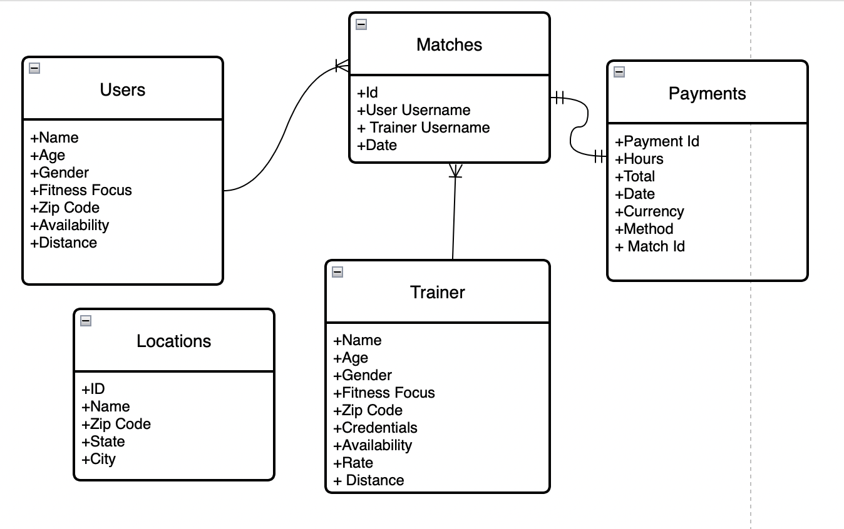
Conceptual Data Model

Slide 7
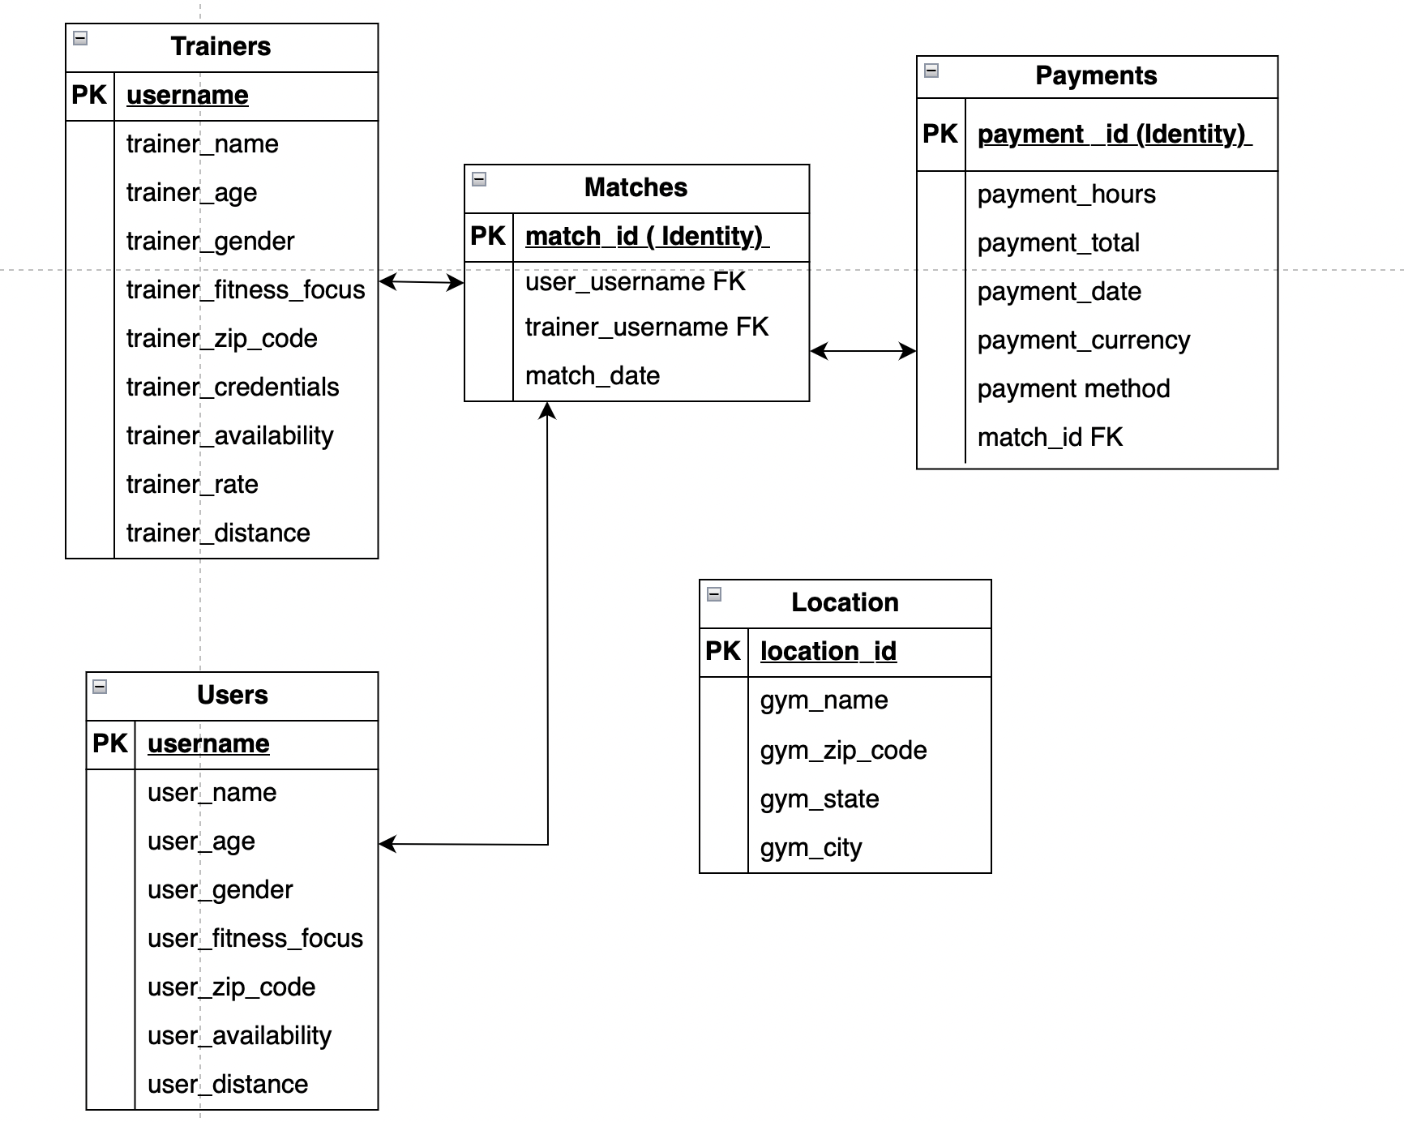
Logical Data Model

Slide 8

Demonstration of Application

Slide 9
Questions ?

